Slide 1
WELCOME to Graduate School
Rick Libby, Ph.D.
Professor of Ophthalmology
Senior Associate Dean of Graduate Education and Postdoctoral Affairs

Slide 2
What we strive for
At the University of Rochester School of Medicine and Dentistry, an environment of respect, inclusiveness, and support is of utmost importance for our learners. You will have the opportunity to learn with and from a diverse group of peers, mentors, faculty, and staff—people are here to help

Slide 3
Core Tenets of Graduate Education
AAMC
Institutional Commitment
Program Commitment
Quality Mentoring
Provision of Skill Sets and Counseling
URMC
Formal classroom education
An apprenticeship
Student support
Career preparation

Slide 4
Balancing it all in Graduate School
Classes
Rotations
Family obligations
Social interactions
Health and wellness
Career development

Slide 5
People are here to help (academically, personally, professionally)
GEPA Office
Program Directors
Faculty (thesis committee)
Department Chairs and Center Directors
Other trainees
Program Coordinators

Slide 6
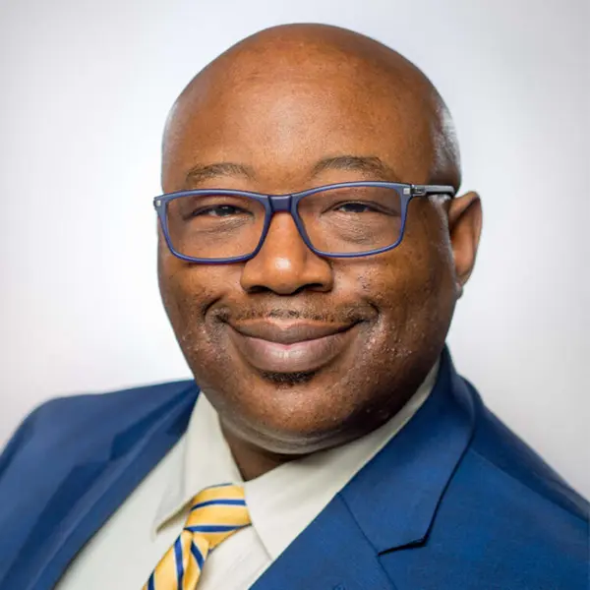
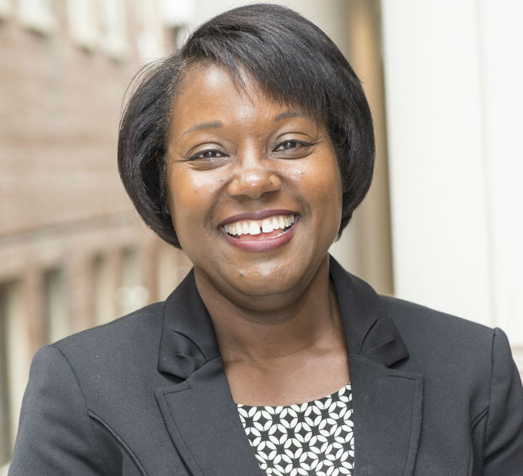
People are here to help (academically, personally, professionally)
John Blackshear PhD
Vice Pres.
Student Life
UofR
Adrienne Morgan PhD
Vice Pres.
Equity and Inclusion
(UofR)

Slide 7
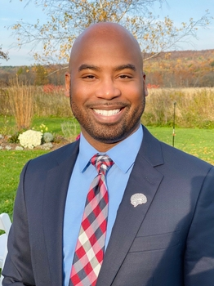
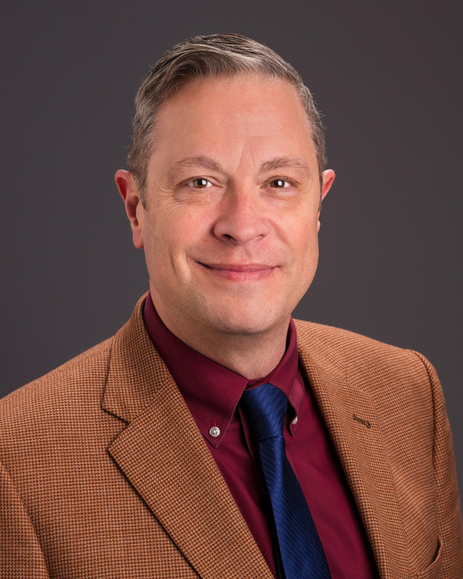
People are here to help (academically, personally, professionally)
Nathan A. Smith, Ph.D. (’13)
Associate Dean
Equity & Inclusion, R & RE
URMC
Craig Rooney PhD
Chief Wellbeing
(URMC)

Slide 8
People are here to help (academically, personally, professionally)
CARE Network (support and student concerns)
https://www.rochester.edu/care/resource-center/
International Services Office (resource for international students)
http://iso.rochester.edu/
University Counseling Center (UCC; Counseling for students)
http://www.rochester.edu/uhs/ucc/
University Health Service (UHS; illness)
http://www.rochester.edu/uhs/
Ombudspersons (confidential, neutral, independent, and informal)
https://www.urmc.rochester.edu/education/post-doctoral/ombudspersons.aspx
Office of Equity and Inclusion
https://www.urmc.rochester.edu/smd/office-of-equity-and-inclusion.aspx
Office of Disability Resources (ODR; accommodations)
https://www.rochester.edu/college/disability/

Slide 9
People are here to help (academically, personally, professionally)
Policy against discrimination and harassment
https://www.urmc.rochester.edu/about-us/values-culture/policies-reporting-resources.aspx
Title IX office
https://www.rochester.edu/sexualmisconduct
General Reporting information
https://www.urmc.rochester.edu/about-us/values-culture/policies-reporting-resources.aspx

Slide 10
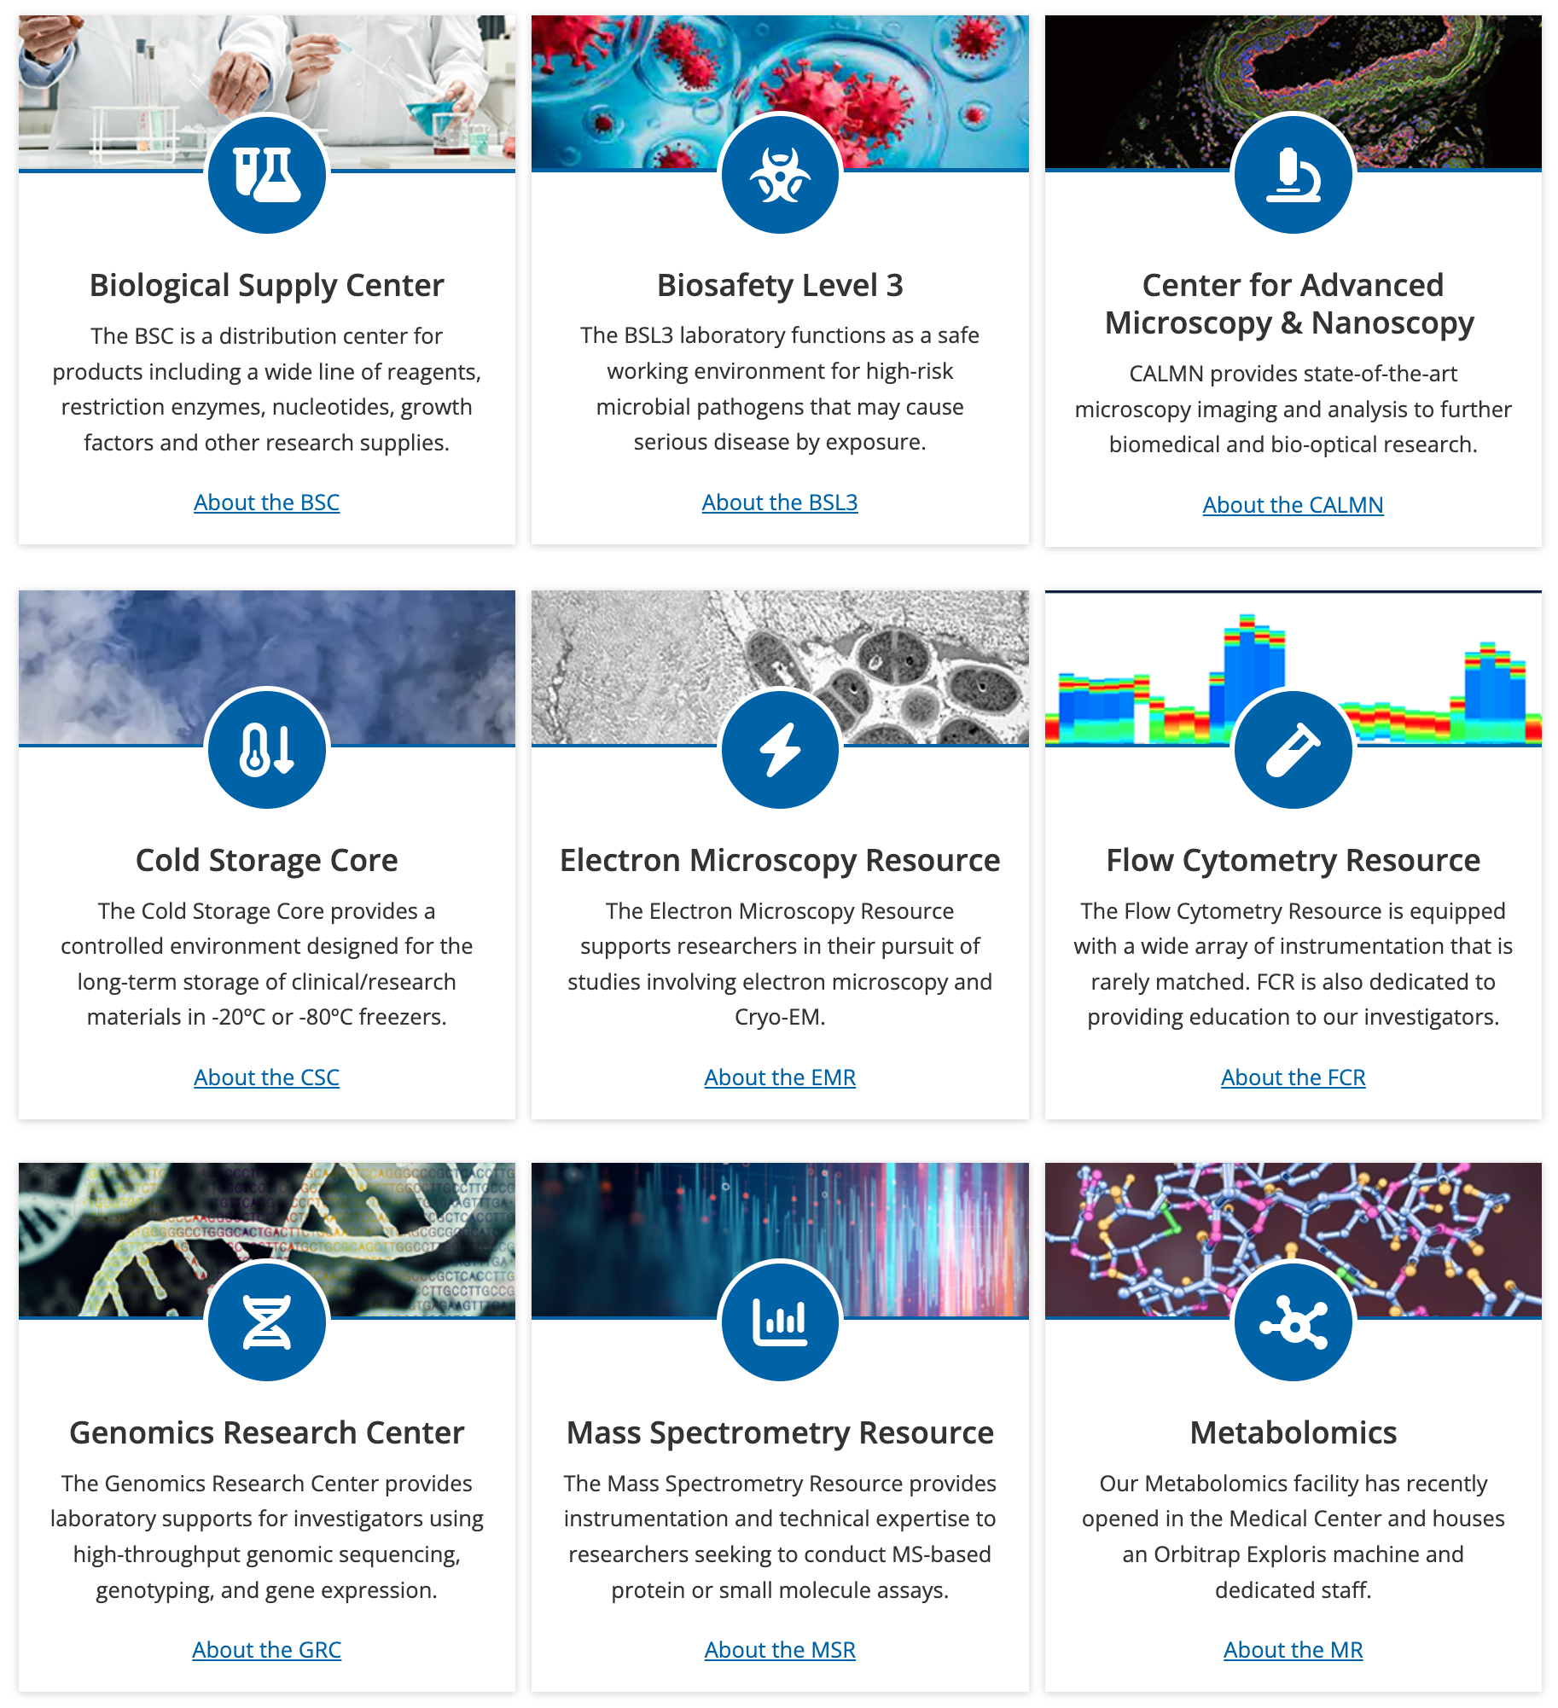
People are here to help (academically, personally, professionally)
Center for Advanced Research Technologies (CORES)

Slide 11
People are here to help (academically, personally, professionally)
8 spokes of myHuB
Alumni
Events
Fellowship & Grants
Research Ethics
Student & Postdoc Groups
URBEST Career Services
URBEST Internships
Writing Services
Find a career
Build skills/get experience
Network with our alumni
Meliora collective
Outcomes
industry, pharm, postdocs, academics, advocacy, writing, government….

Slide 12
People are here to help (academically, personally, professionally)
SMD Graduate Student Society
https://www.urmc.rochester.edu/education/graduate/current-students/graduate-student-society/graduate-student-life.aspx

Slide 13
People are here to help (academically, personally, professionally)
ADSE, Alliance for Diversity in Science and Engineering
to increase the participation of underrepresented groups in academia, industry, and government through graduate student organizations that reach out to students and scientists of all ages and backgrounds.
GWIS, Graduate Women in Science
to provide mentoring for the professional and personal development of all graduate women at the URMC and ASE.
GSRF, Graduate Students Raising Families
to find solutions to alleviate the problems that students have while balancing family life and pursuing their degrees.
outGRADS
dedicated to forming a community of gender and sexual minorities
GSS, Graduate Student Society

Slide 14
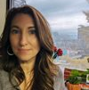
People are here to help (academically, personally, professionally)
Graduate Student Association
Amber Rivera MSW
Director of Learner Life and Wellness
Ensuring trainees’ awareness of and access to the academic and non-academic resources required for a positive and productive educational experience
CARE Network liaison

Slide 15
Expectations
Expectations of Graduate Students
Expectations of Research Advisors
https://www.urmc.rochester.edu/education/graduate/home/forms.aspx

Slide 16
Expectations
I acknowledge that I have the primary responsibility for the successful completion of my degree.
I will be committed to the education and training of the graduate student.
I will be committed to the research project of the graduate student.

Slide 17
First Year
Complete classes, successfully (grades)
Complete 3 rotations with a satisfactory score (basic science PhDs)
Find a research “home” or thesis project (where applicable)
Build your skill base
Explore

Slide 18
Advice for your First Year
First year good time to stick your toes in the water
Focus on exploration and skills for your research
One year Master’s programs—get going!
Explore your career options throughout your time here
Begin to develop your network and connect with fellow trainees and UR alumni: Alumni Group on LinkedIn and The Meliora Collective
Stay connected with what is happening in myHub Opportunities to Explore (OTE)

Slide 19
Advice for your First Year
Set goals and work to meet them
Seek help when needed
Develop mentor, advisor, and peer networks
Be scientifically curious
Make friends/socialize
Learn and make use of new technologies
Become part of the community
Enjoy the process

Slide 20
Choosing a project/mentor!
Perhaps the most important decision you make in grad school and in postdoc
Oversees the environment you will spend considerable time in
Responsible for providing most of your scientific training
Attack questions like your advisor
In some ways, also picking an area of expertise
Can be a great asset for your entire career
Purpose of rotation (where applicable)
Something wrong, reach out—people are here to help!

Slide 21
Choosing a project/mentor!
What we tend to look for
Trendy science
High impact papers
What we should look for
Good solid science
Something that we are very interested in
Good, attentive advisor (and mentor)
Environment where you think you will thrive
Big difference between an advisor and a mentor
Bullet points are not mutually exclusive

Slide 22
Individualized Development Plans
Go to: http://myidp.sciencecareers.org/
Evaluate skills, values, and interests
Explore and evaluate career opportunities
Set specific goals for your career path
Discuss with your advisor/mentor
Put your plan in place

Slide 23
ORCID
ORCID is a unique identifier that makes it easier to distinguish, organize, and share your work
Free, researcher controlled, and owned
Can use on grant applications and manuscript submissions
Register and complete your profile at orcid.org
Please take a moment to connect to the UR Reporting System, takes less than a minute - orcid.lib.rochester.edu
Need help, contact your librarian or Daniel_Castillo@urmc.Rochester.edu at Miner Library

Slide 24
Communications

Slide 25
Orientation Resources
https://www.urmc.rochester.edu/education/graduate/incoming-graduate-student-orientation.aspx
Student Handbook
GEPAs
Individual programs
University GEPA
https://www.rochester.edu/college/gradstudies/current/policies/index.html

Slide 26
Questions?
Progress is made by young scientists who carry out experiments that old scientists said wouldn't work. – Frank Westheimer

Slide 28
Incoming Class
Certificate, Masters, Doctoral Programs
8, 15, 12
162 incoming students
28, 57, 77
Range of Disciplines
Epidemiology to Genetics to MFT
Diverse Student Population
16 countries
23 state
Average Age 25

Slide 29
Expectations
I will be knowledgeable of the policies and requirements of my graduate program, graduate school, and institution.
I will comply with all institutional policies, including academic program milestones.
I will be knowledgeable of, and guide the graduate student through, the requirements and deadlines of his/her graduate program as well as those of the institution, including teaching requirements and human resources guidelines.

Slide 30
I will provide for every graduate student under my supervision an environment that is intellectually stimulating, emotionally supportive, safe, and free of harassment.
Throughout the graduate student’s time in my group, I will strive to be supportive, equitable, accessible, encouraging, and respectful.

